Slide 1

Finding MIMO
Weekly Meeting: Week 7
Kate Bowers, Kristopher Jung, Samuel Spillane

Slide 2
Project Goals
Model receiver-side CEs to determine the best way to decode received signals
Choose equalization algorithm and parameters
Choose channel estimation technique
Optimize parameters for the best Bit Error Rate (BER), Power Gain, or throughput

Slide 3

Progress and challenges
Kate worked on MIMO Watterson baseline
Modular implementation for testing equalizer designs in parallel
Validity checking of existing models using Rayleigh and AWGN channels
Kris worked on equalizers and Genetic Algorithm.
Still have issues on equalizers.
Training stepsize/# forward taps/ # feedback taps
Population = 50
Generations = 100

Slide 4
Progress and challenges Contd.
Sam worked on Q-Learning.
Developed method for exhaustive action space transversal
Even with advanced programming techniques(backtracking, dynamic programming, branch and bound) the process of creating an exhaustive action space for multiple variables still uses too much memory for sufficiently large variable ranges.
Therefore, I am finalizing a model for to reduce the number of parameters for each q-learning session and therefore increasing the available action space.

Slide 5
Progress and challenges Contd.
Overall discussion of design specifications of CE
Testing design with Q-Learning as a possible final design, will revisit this week
Determination of variables to be controlled by the CE
Step size
Feedback/feed-forward taps
Forgetting factor
Equalizers

Slide 6
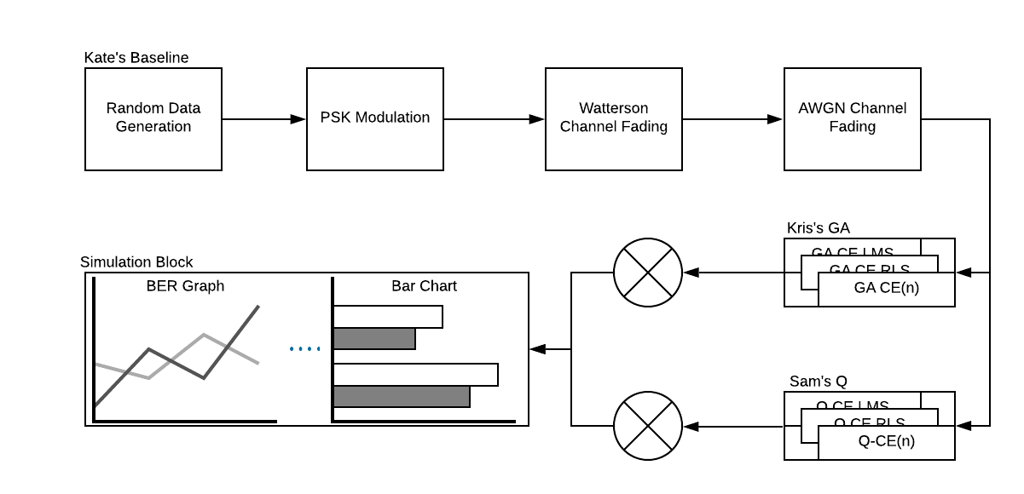
End-game research design.

Slide 7
Roadmap
Week 7
Finalize q-learning and genetic algorithm.
Synchronize all works.
Fix issues in equalizers together.
Week 8-10
Other tasks
Research paper writing
Research poster/video for presentation (Are we supposed to do a poster or video?)

Slide 8
Questions?

